Slide 1
PART 5 Transport Layer

Slide 2
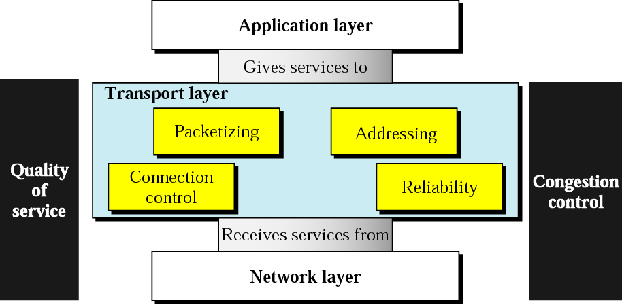
Position of Transport Layer
Responsible for the delivery of a message from one process to another

Slide 3
Chapter 23. Process-to-Process Delivery UDP, TCP, and SCTP
23.1 Process-to-Process Delivery
23.2 UDP
23.3 TCP
23.4 SCTP

Slide 4
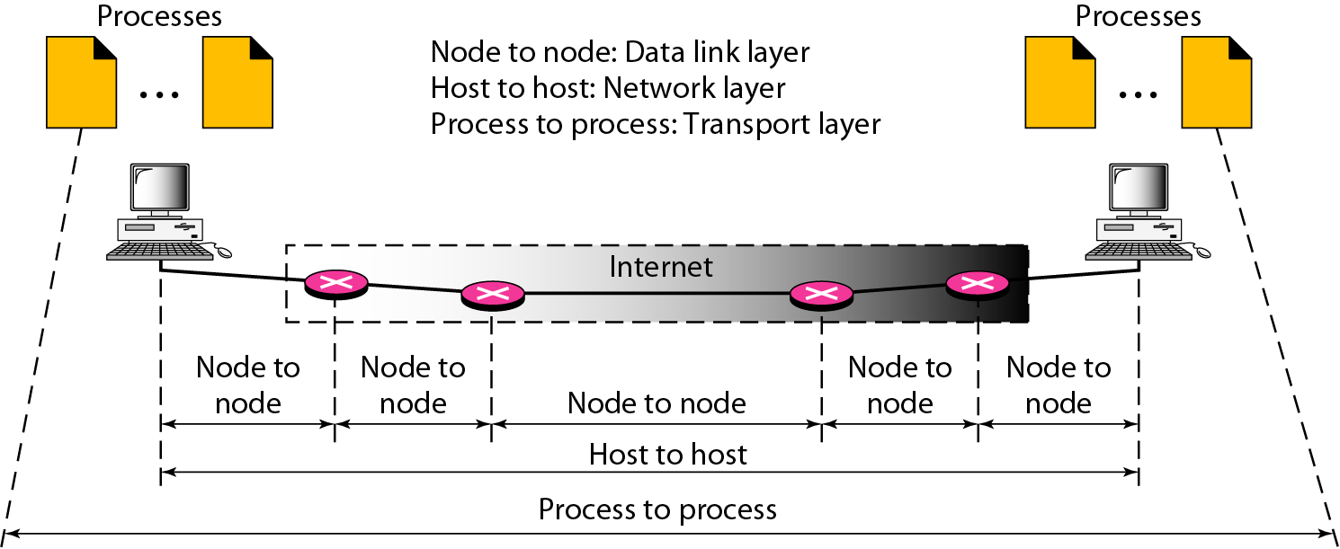
Types of data deliveries
The transport layer is responsible for process-to-process delivery.
Process (application program ??)

Slide 5
Client-Server Paradigm
Most common process-to-process communication is the client-server paradigm
Operating systems support multiuser and multiprogramming environments.
Local host, local process, remote host, remote process must be defined
Addressing
Address required for delivery
Transport layer address: port number

Slide 6
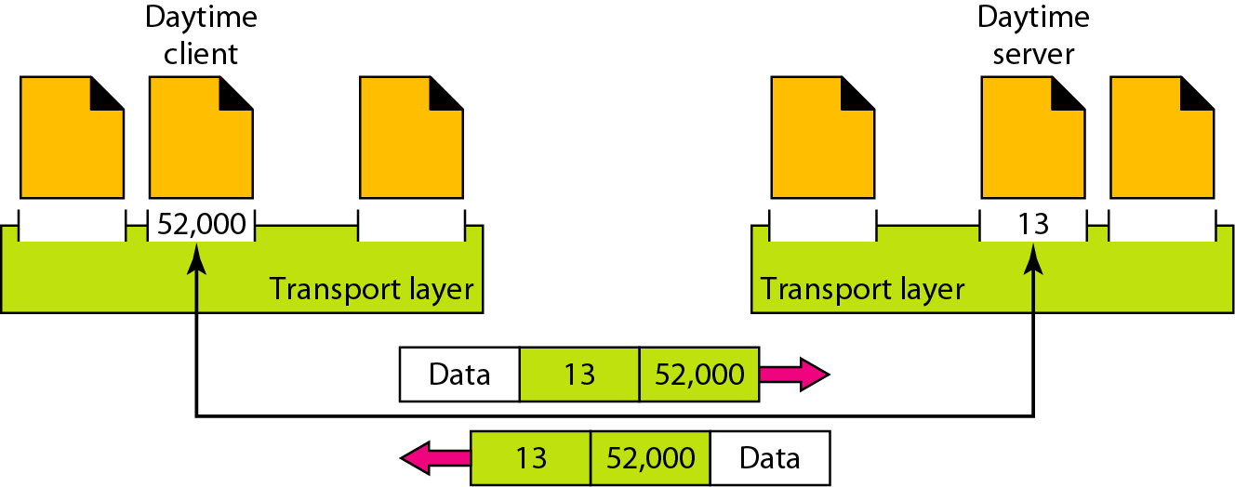
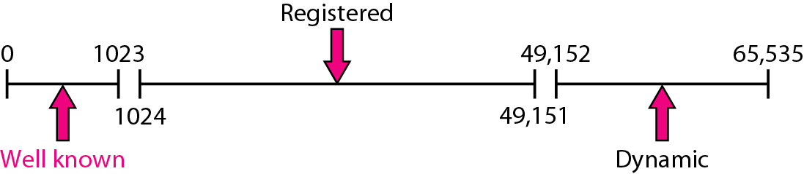
Port Numbers
16 bits between 0 and 65553: ephemeral port number
IANA (Internet Assigned Number Authority) range: well-known ports, registered ports, dynamic ports

Slide 7
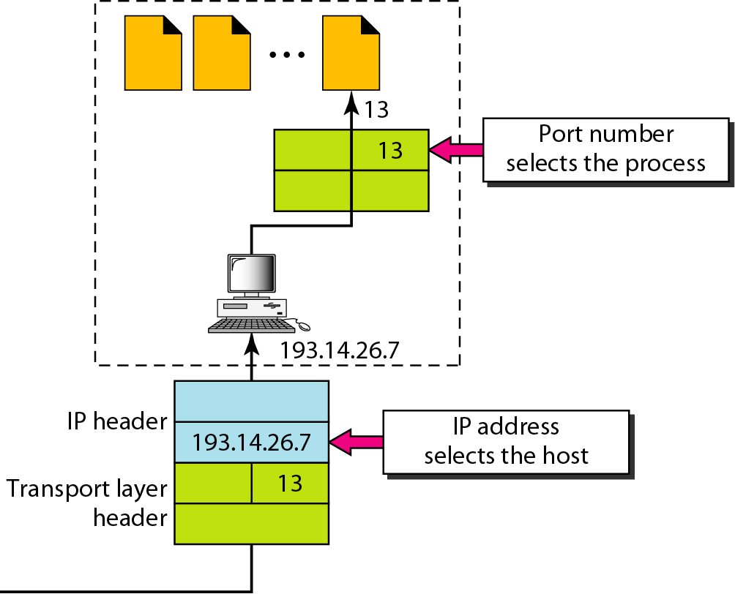
IP Addresses vs. Port Numbers

Slide 8
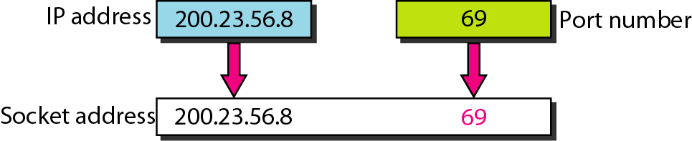
Socket address
Process-to-process delivery needs two identifiers, IP address and the port number
Socket address is the combination of an IP address and a port number
A transport-layer protocol needs a pair of socket addresses; the client and server socket address

Slide 9
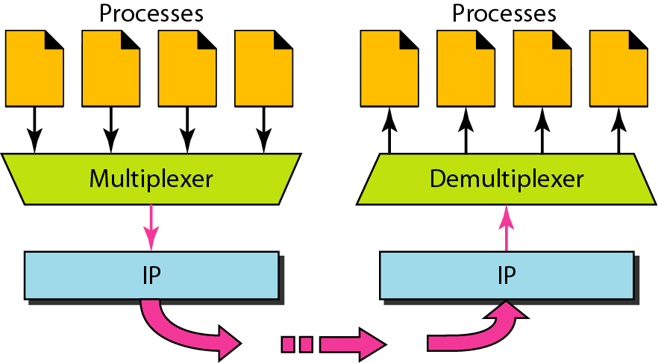
Multiplexing and demultiplexing
Addressing mechanism allows multiplexing and demultiplexing by the transport layer

Slide 10
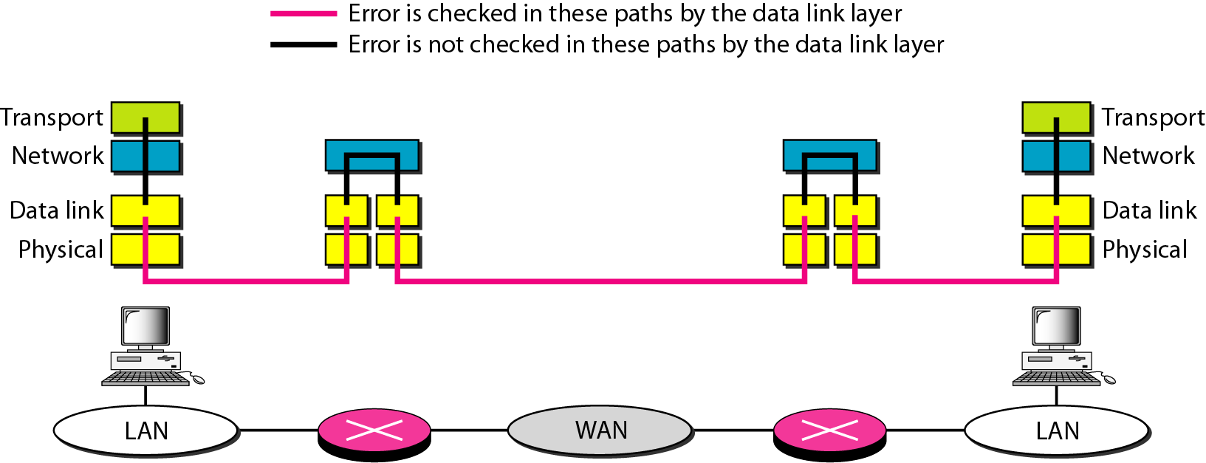
Connectionless vs. Connection-oriented
Connection-oriented: connection established, data transferred, connection released
TCP and SCTP
Connectionless: UDP
Reliable vs. Unreliable

Slide 11
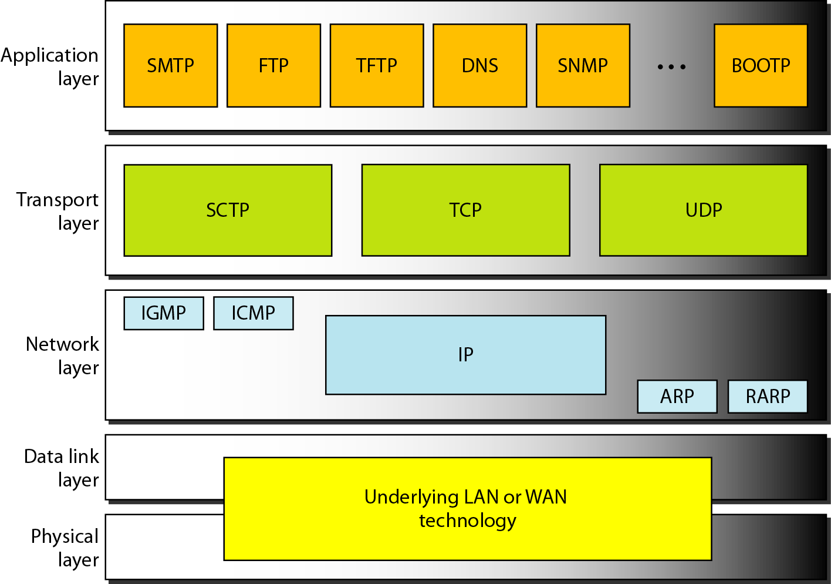
Position of UDP, TCP, and SCTP

Slide 12
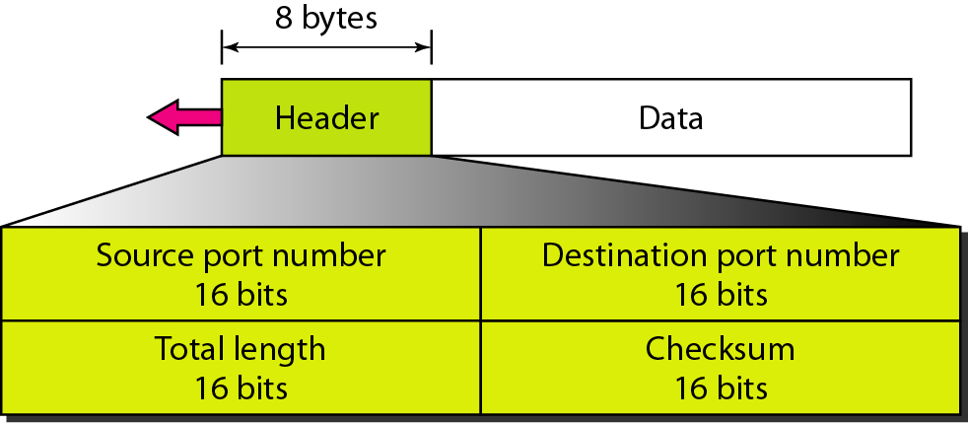
UDP
The User Datagram Protocol (UDP) is called a connectionless, unreliable transport protocol. It does not add anything to the services of IP except to provide process-to-process communication instead of host-to-host communication
UDP is a convenient transport-layer protocol for applications that provide flow and error control. It is also used by multimedia applications.
The calculation of checksum and its inclusion in the user datagram are optional

Slide 13
Well-known Ports for UDP

Slide 14
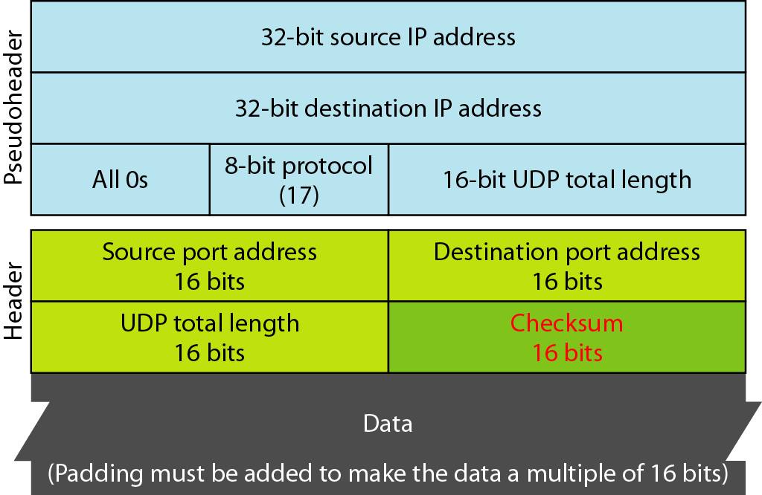
UDP: Checksum
Checksum includes three section: a pseudoheader, the UDP header, and the data from the application layer

Slide 15
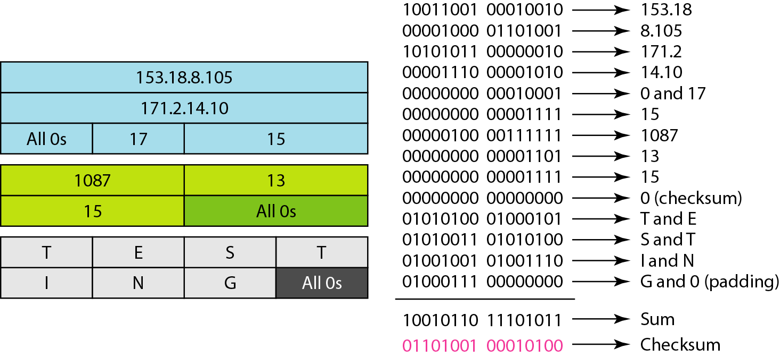
UDP: Checksum
Example for checksum calculation of a simple UDP user datagram

Slide 16
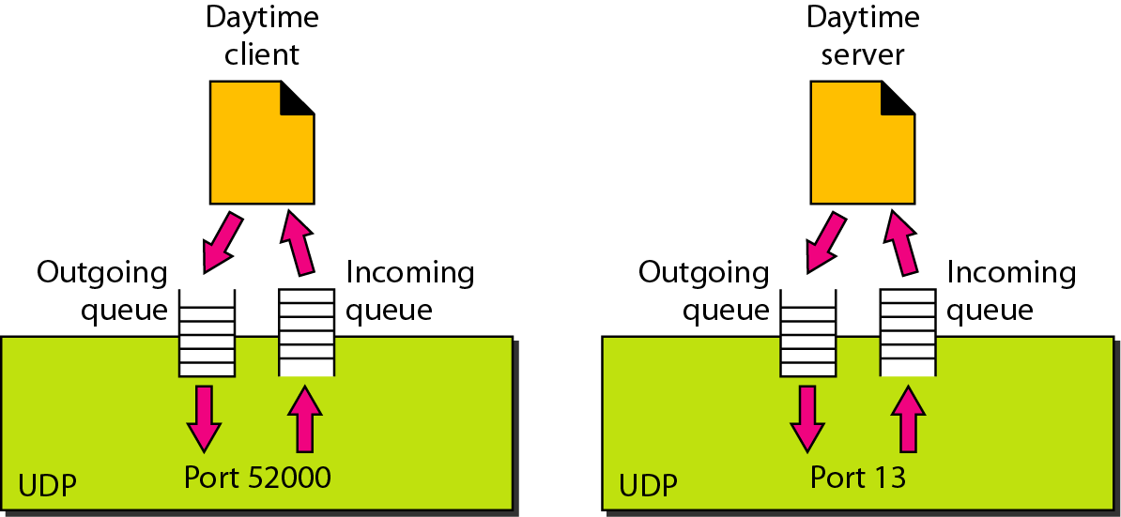
UDP Operation
Connectionless services
Flow and error control: no control without checksum
Encapsulation and decapsulation
Queuing

Slide 17
Use of UDP
Suitable for a process that requires simple request-response communication with little concern for flow and error control
Suitable for a process with internal flow and error control mechanisms such as TFTP
Suitable for multicasting
Used for management processes such as SNMP
Used for some route updating protocols such as RIP

Slide 18
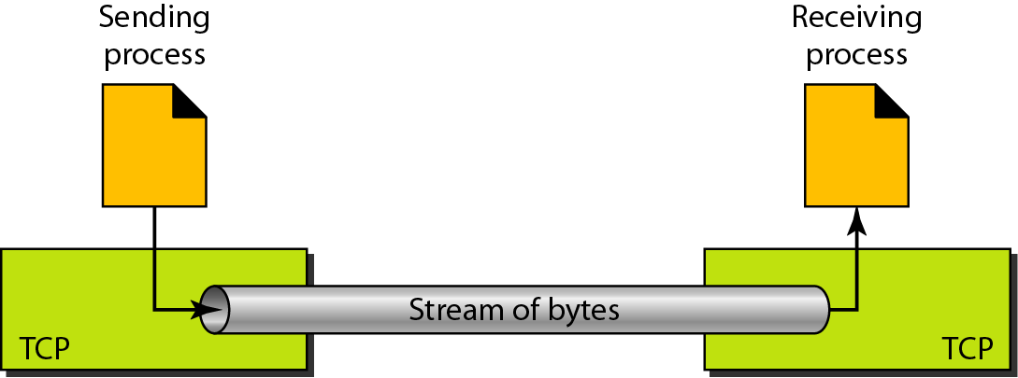
TCP
Transmission Control Protocol
Connection-oriented, reliable transport protocol
It adds connection-oriented and reliability features to the services of IP
Like UDP, TCP uses port numbers as transport-layer addresses
Unlike UDP, TCP is a stream-oriented protocol

Slide 19
Well-known Ports for TCP

Slide 20
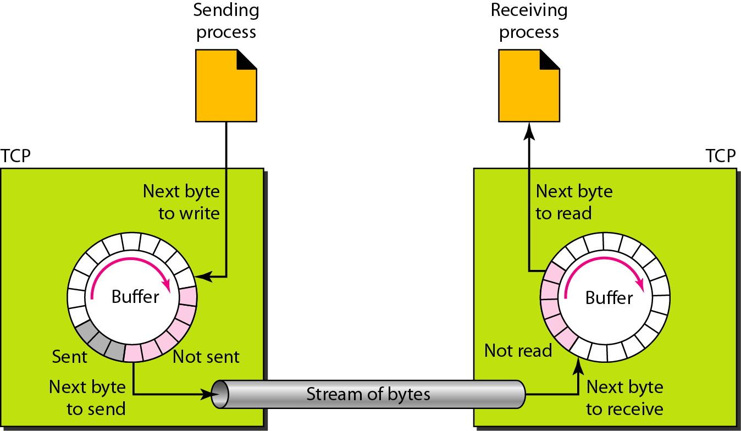
Sending and Receiving Buffers
Buffering handles the disparity between the speed of the producing and consuming processes
One example: to use a circular array of 1-byte locations

Slide 21
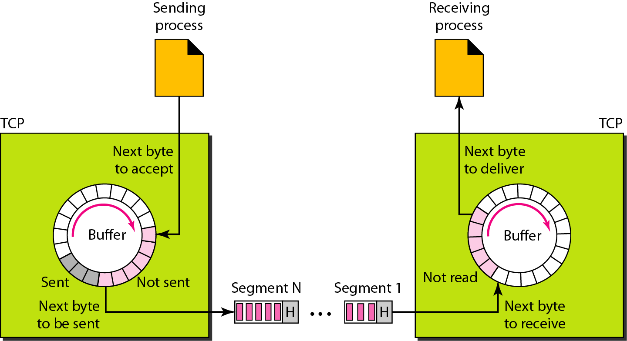
TCP Segments
IP layer needs to send data in packets not as a stream of byte

Slide 22
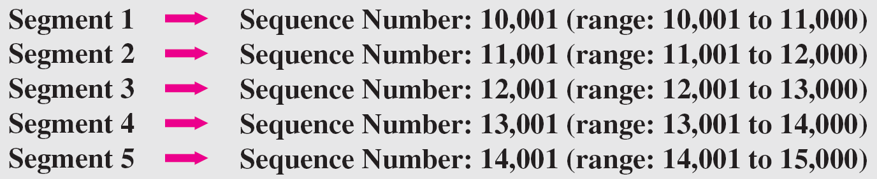
TCP Features
Numbering system: sequence number and acknowledgment number
Byte number: The bytes of data being transferred in each connection are numbered by TCP. The numbering starts with a randomly generated number
The value in the sequence number field of a segment defines the number of the first data byte contained in that segment
The value of the acknowledgment field in a segment defines the number of the next byte a party expects to receive. The acknowledgment number is cumulative

Slide 23
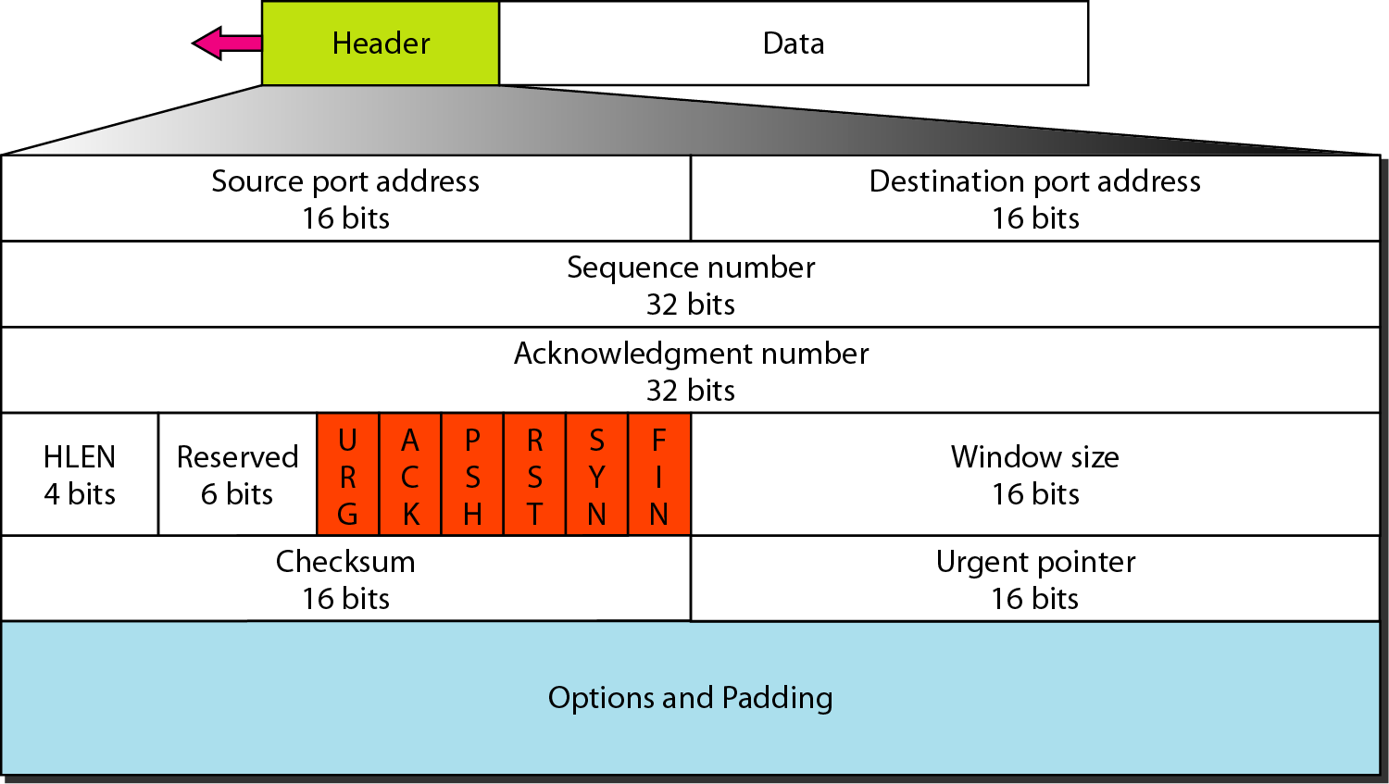
TCP Segment Format

Slide 24
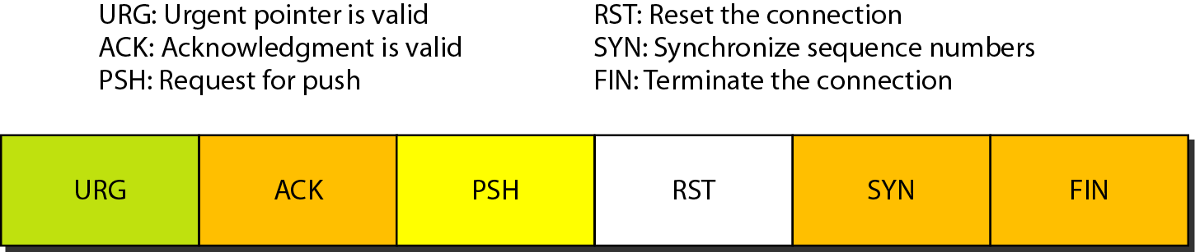
TCP Control Field

Slide 25
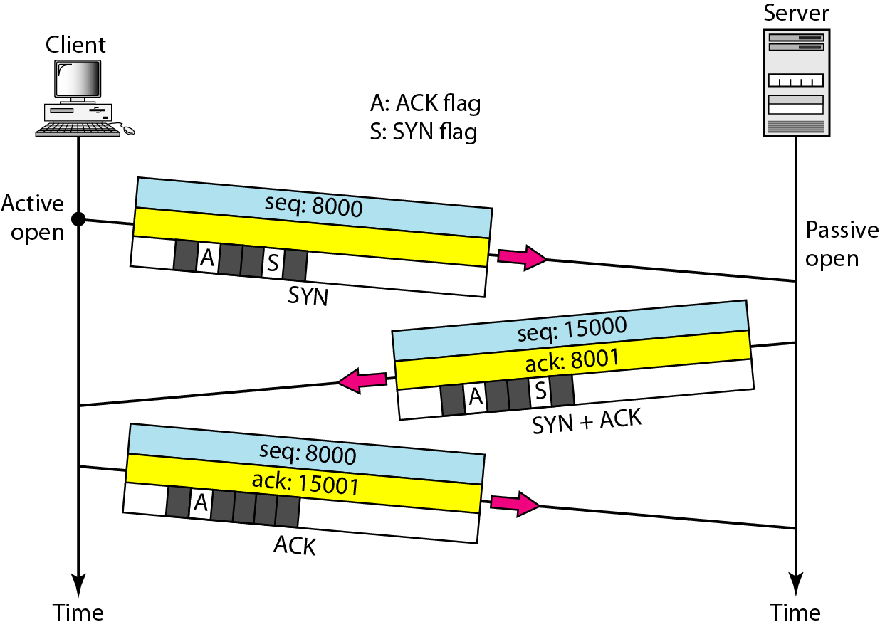
A TCP Connection: Establishment
Connection establishment: Three-way handshaking
A SYN segment cannot carry data, but it consumes one sequence number
A SYN + ACK segment cannot carry data, but does consume one sequence number
An ACK segment, if carrying no data, consumes no sequence number
Simultaneous open and SYN flooding attack (denial-of service attack, cookie)

Slide 26
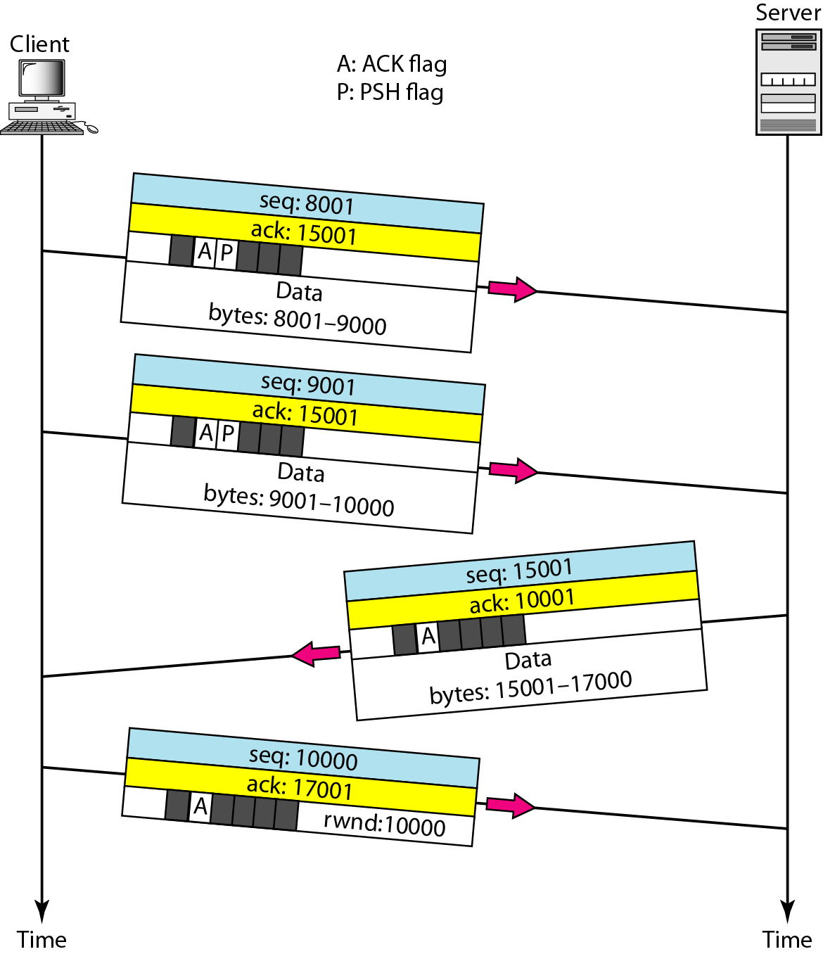
A TCP Connection: Data Transfer
After connection is established, bidirectional data transfer can take place
Pushing data and urgent data

Slide 27
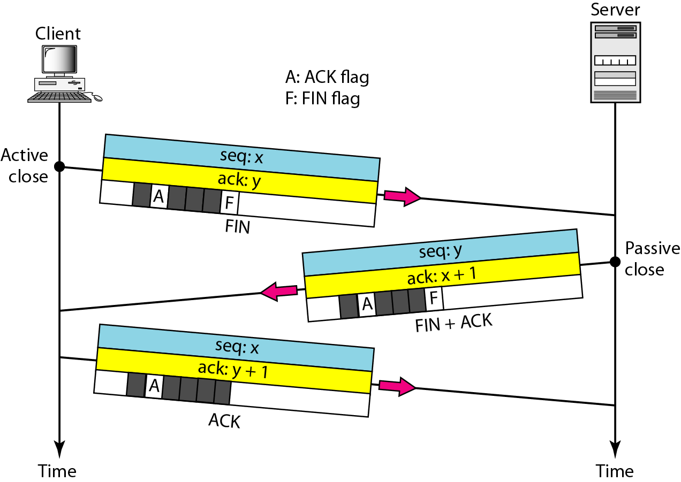
A TCP Connection: Connection Termination
Three-way handshaking
The FIN segment consumes one sequence number if it does not carry data
The FIN + ACK segment consumes one sequence number if it does not carry data

Slide 28
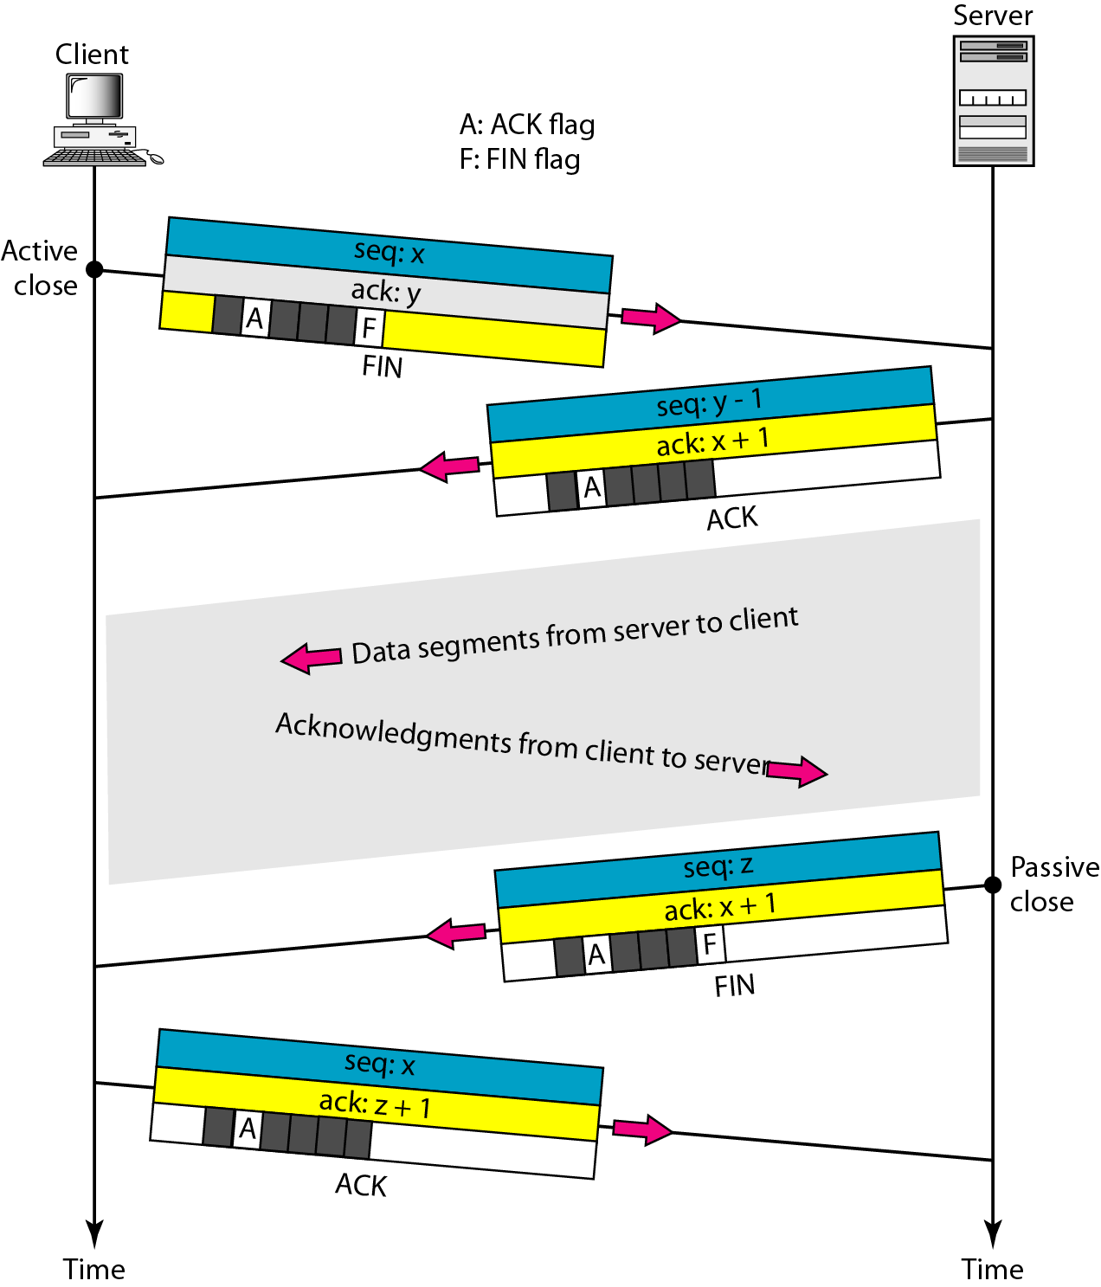
Connection Termination: Half-Close

Slide 29
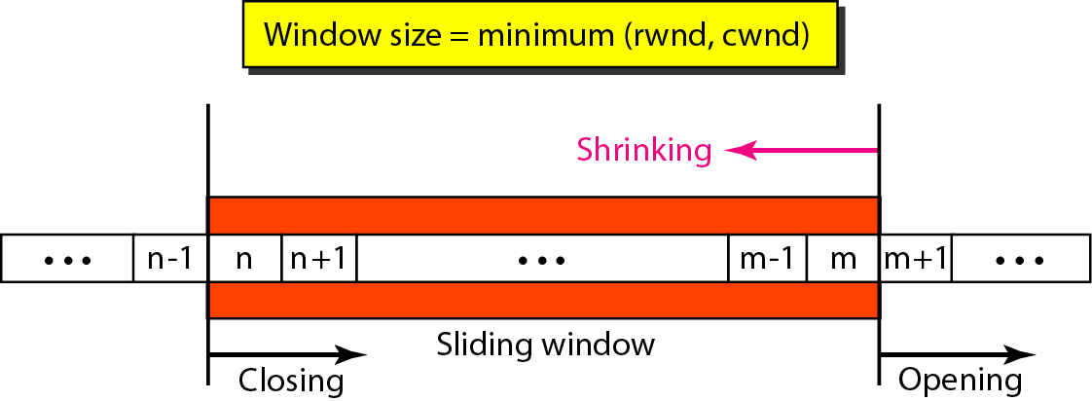
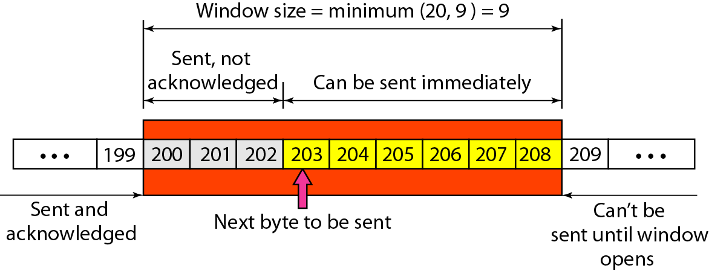
Flow Control
A sliding window is used to make transmission more efficient as well as to control the flow of data so that the destination does not become overwhelmed with data. TCP sliding windows are byte-oriented.

Slide 30
TCP Sliding Window
❏ The size of the window is the lesser of rwnd and cwnd.
❏ The source does not have to send a full window’s worth of data.
❏ The window can be opened or closed by the receiver, but should not be
shrunk.
❏ The destination can send an acknowledgment at any time as long as it
does not result in a shrinking window.
❏ The receiver can temporarily shut down the window; the sender,
however, can always send a segment of 1 byte after the window is shut
down.

Slide 31
Error Control
Error detection and correction in TCP is achieved through the use of three simple tools: checksum, acknowledgment, and time-out
Checksum: If corrupted, it is discarded and considered as lost
Acknowledgment:
ACK segments do not consume sequence numbers and are not acknowledged
Retransmission:
In modern implementations, a retransmission occurs if the retransmission timer expires or three duplicate ACK segments have arrived
No retransmission timer is set for an ACK segment
Retransmission after RTO (Retransmission Time-Out): RTO is updated based on the RTT (Round Trip Time)
Retransmission after three duplicate ACK segments
Out-of-order segments
Data may arrive out of order and be temporarily stored by the receiving TCP, but TCP guarantees that no out-of-order segment is delivered to the process

Slide 32
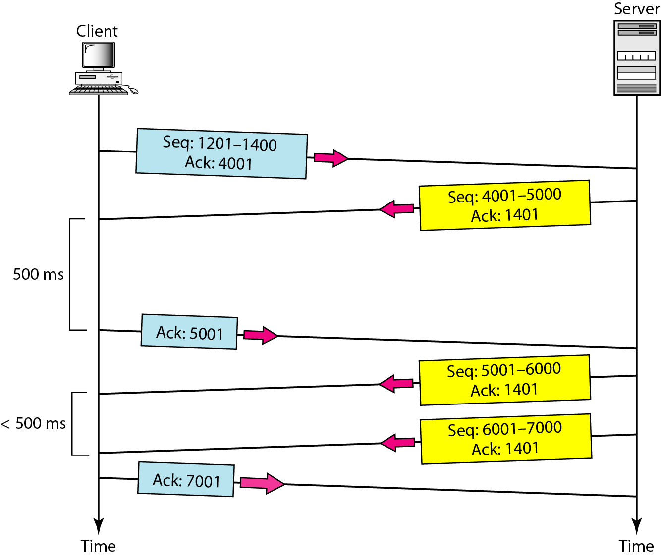
TCP Scenarios
Normal Operation

Slide 33
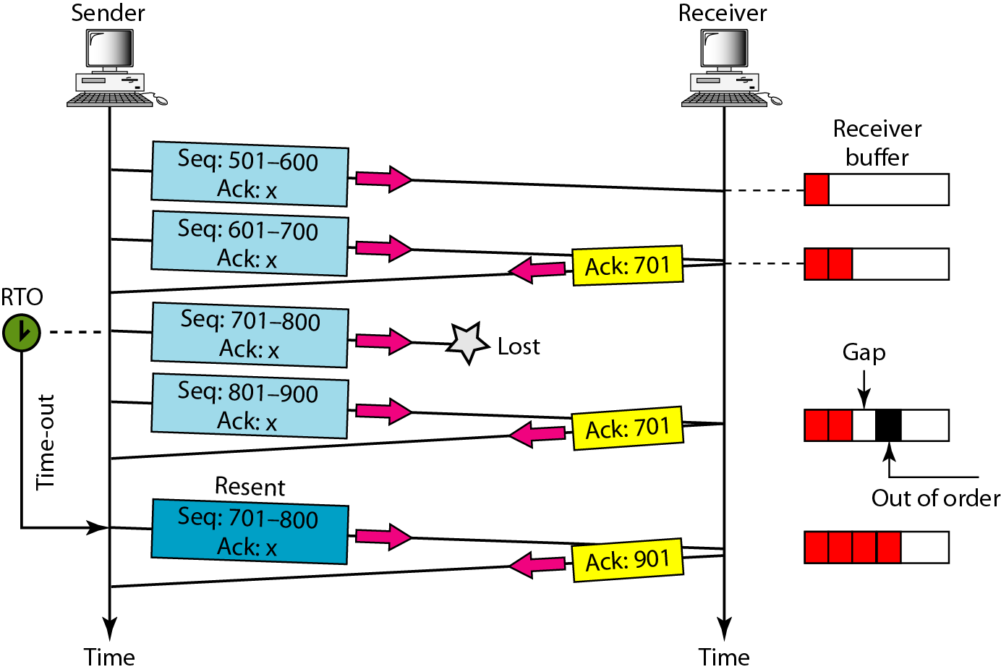
TCP Scenarios
Lost Segment
The receiver TCP delivers only ordered data to the process

Slide 34
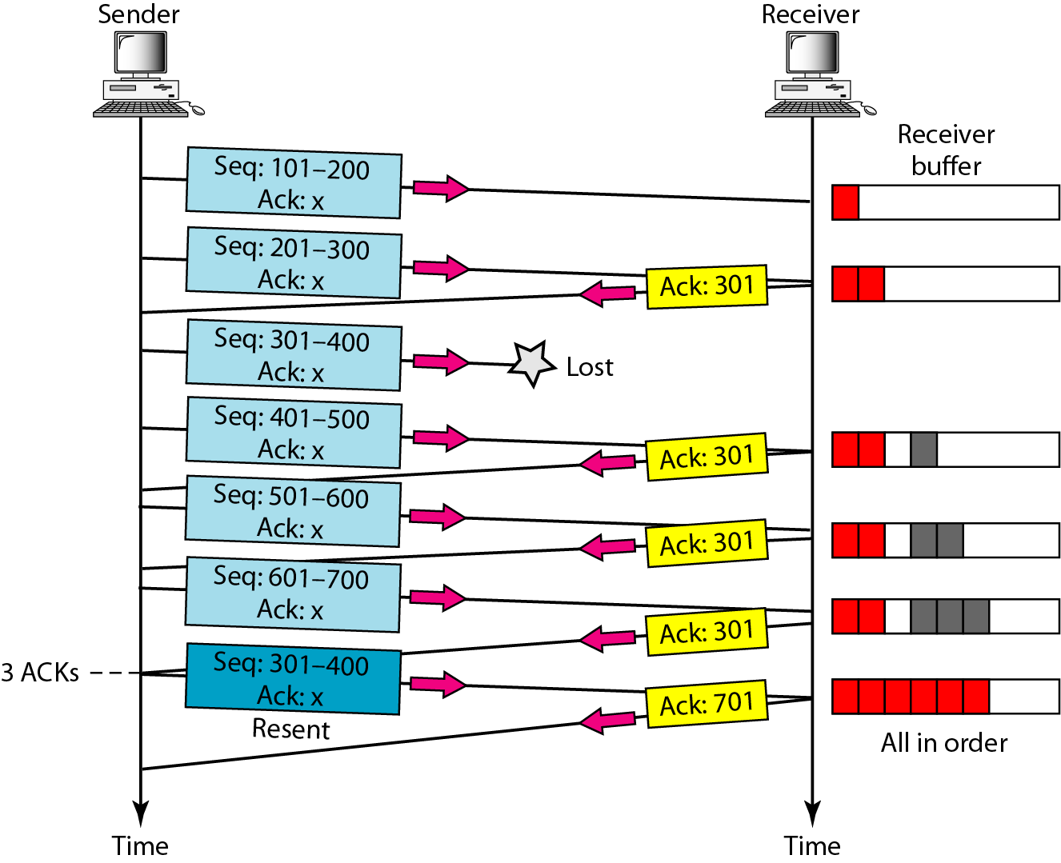
TCP Scenarios
Fast retransmission

Slide 35
SCTP
Stream Control Transmission Protocol (SCTP) is a new reliable, message-oriented transport layer protocol that combines the best features of UDP and TCP
SCTP Services:
Process-to-process communication: use all well-known ports in TCP
Multiple streams
Multihoming
Full-duplex communication
Connection-oriented service
Reliable service

Slide 36
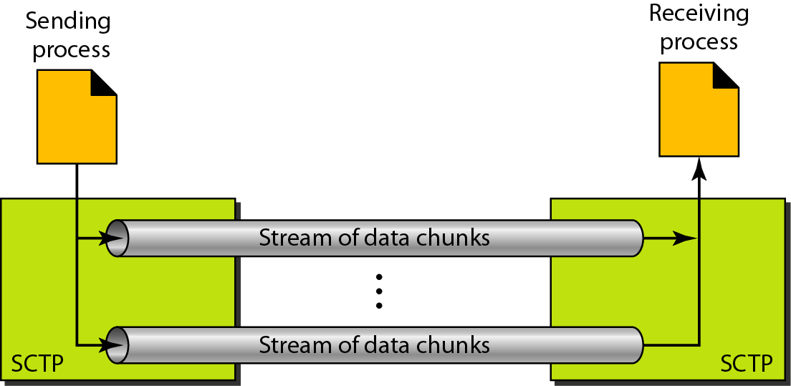
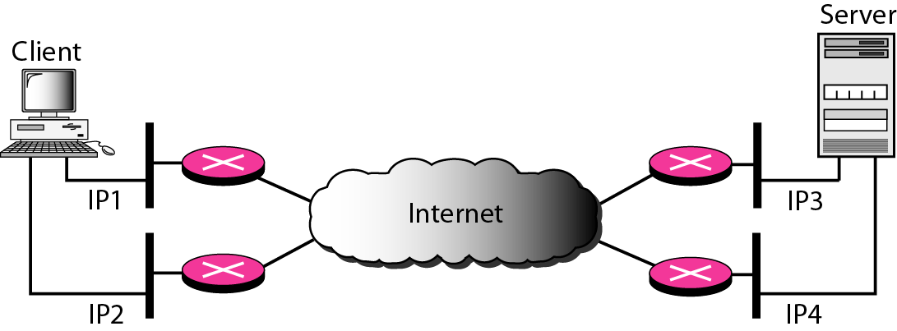
SCTP Services
Multiple streams: An association in SCTP can involve multiple streams
Multihoming: SCTP association allows multiple IP addresses for each end

Slide 37
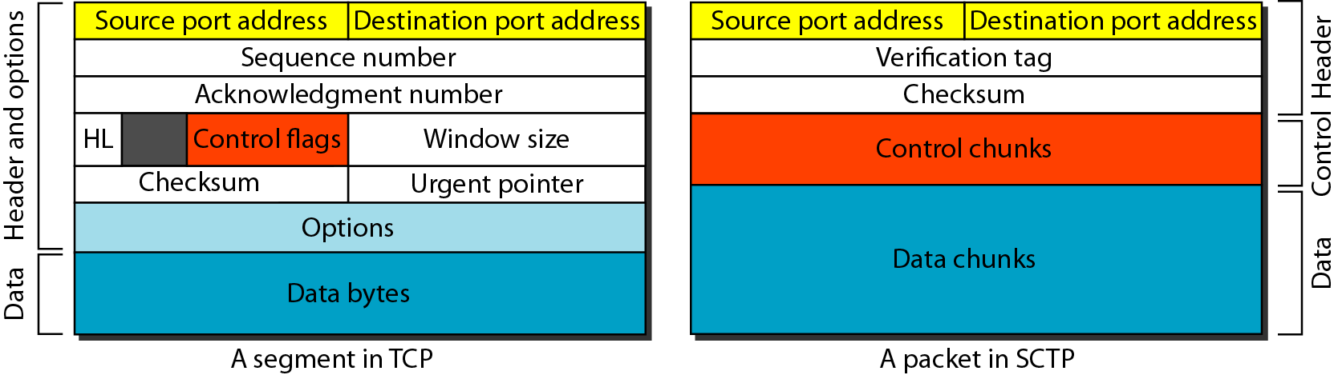
SCTP Features
Transmission sequence number is used to number a data chunk
Stream identifier (SI) to distinguish between different streams
Stream sequence number to distinguish between different data chunks belong to the same stream
Packets: TCP has segments; SCTP has packets
In SCTP, control information and data information are carried in separate chunks

Slide 38
Differences between SCTP and TCP
The control information in TCP is part of the header; the control information in SCTP is included in the control chunks
The data in a TCP segment treated as one entity; an SCTP packet can carry several data chunks
The option section, which can be part of a TCP segment, does not exist in an SCTP packet
The mandatory part of the TCP header is 20 bytes, while the general header in SCTP is only 12 bytes
The checksum in TCP is 16 bits; in SCTP, it is 32 bits
The verification tag in SCTP is an association identifier, which does not exist in TCP
TCP includes one sequence number in the header, which defines the number of the first byte in the data section. AN SCTP packet can include several different data chunks
Some segments in TCP that carry control information (such as SYN and FIN) need to consume one sequence number; control chunks in SCTP never use a TSN, SI, or SSN

Slide 39
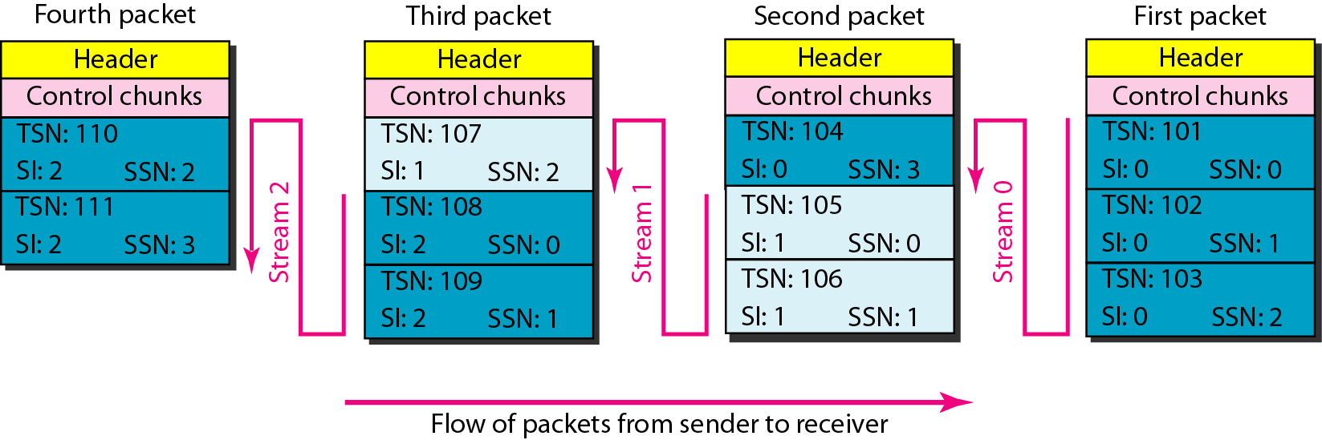
Packet, Data Chunks, and Stream
Data chunks are identified by three items: TSN, SI, and SSN. TSN is a cumulative number identifying the association; SI defines the stream; SSN defines the chunk in a stream
Acknowledgment Number
In SCTP, acknowledgment numbers are used to acknowledge only data chunks; control chunks are acknowledged by other control chunks if necessary

Slide 40
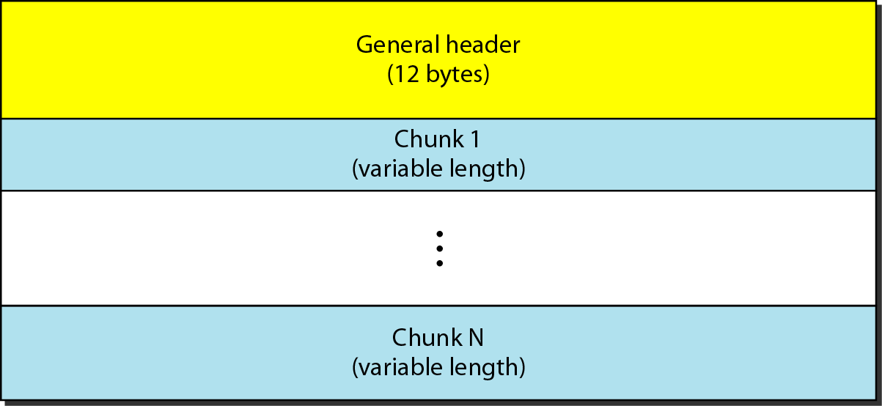
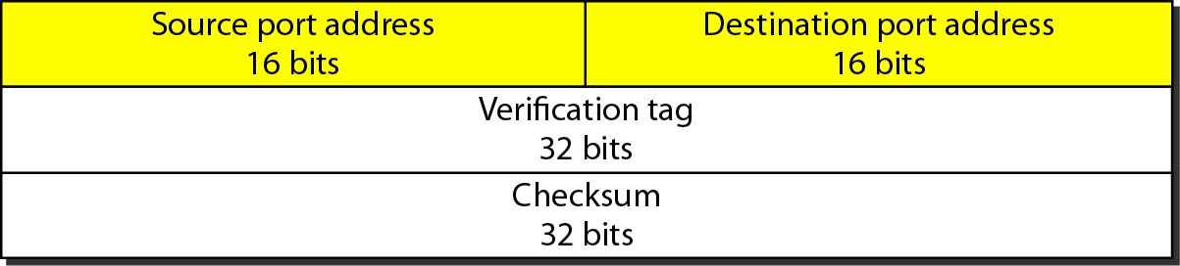
SCTP Packet Format
In an SCTP packet, control chunks come before data chunks
General Header

Slide 41
SCTP Chunks

Slide 42
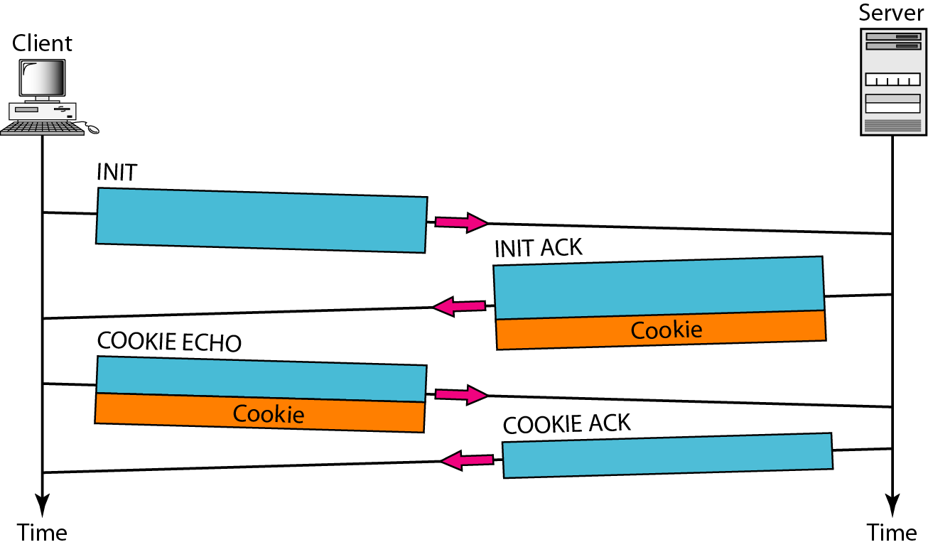
SCTP Association
SCTP, like TCP, is a connection-oriented protocol
A connection in SCTP is called an association to emphasize multihoming
Association establishment requires a four-way handshake
No other chunk is allowed in a packet carrying an INIT or INIT ACK chunk. A COOKIE ECHO or a COOKIE ACK chunk can carry data chunks

Slide 43
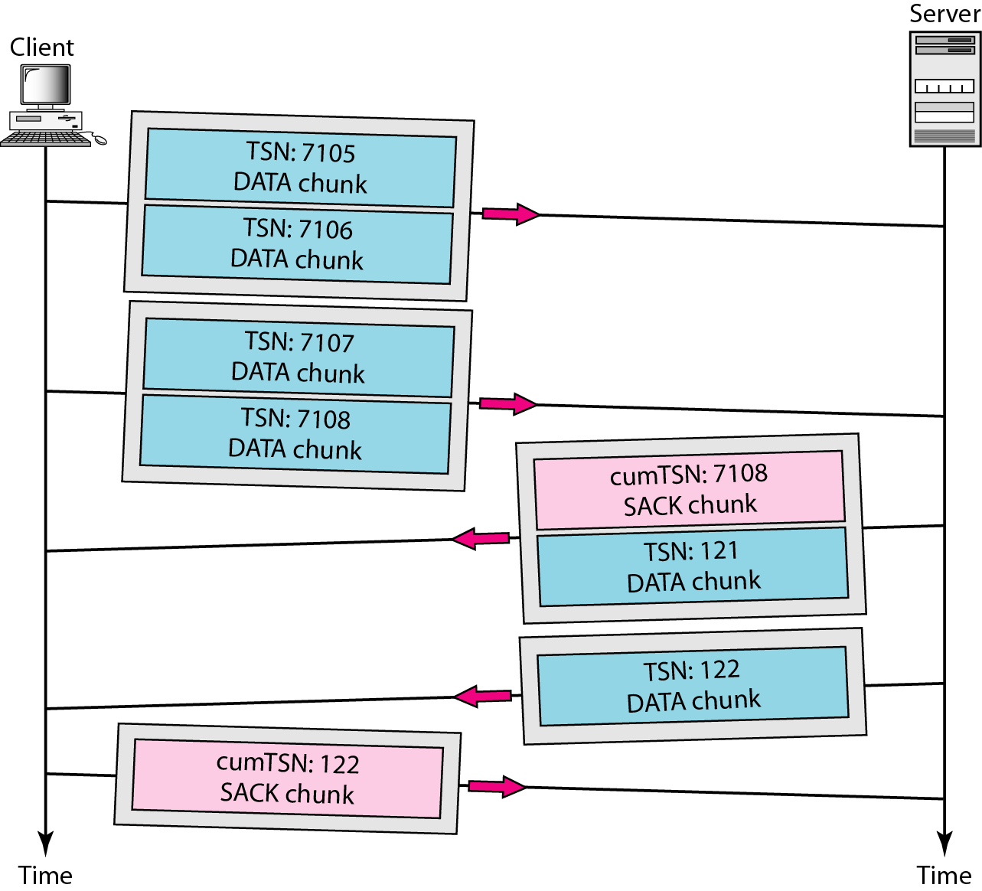
SCTP Association: Data Transfer
Bidirectional data transfer
Like TCP, SCTP supports piggybacking
In SCTP, only DATA chunks consume TSNs; DATA chunks are the only chunks that are acknowledged
The acknowledgment in SCTP defines the cumulative TSN, the TSN of the last data chunk received in order

Slide 44
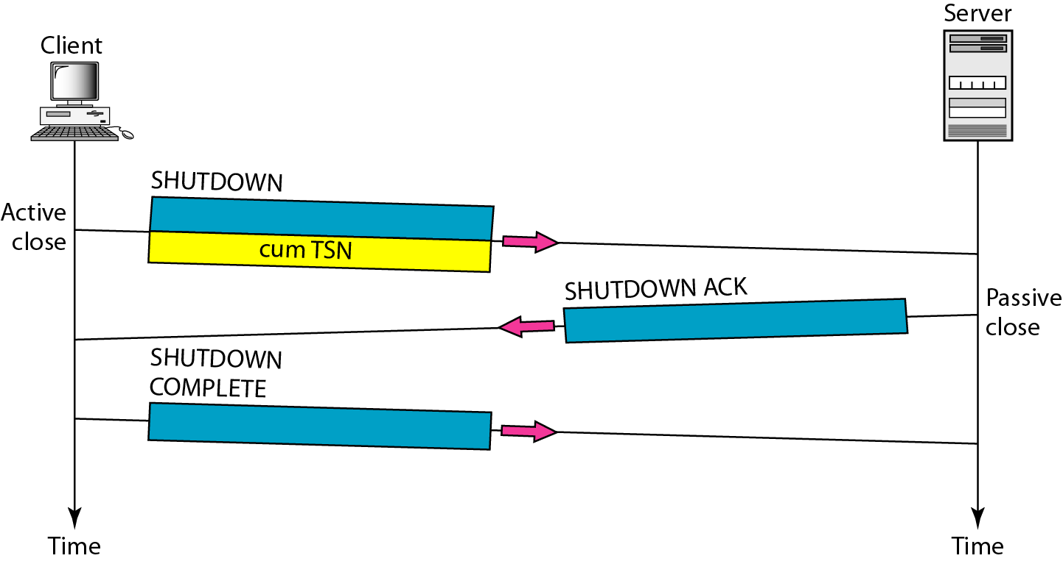
Association Termination

Slide 45
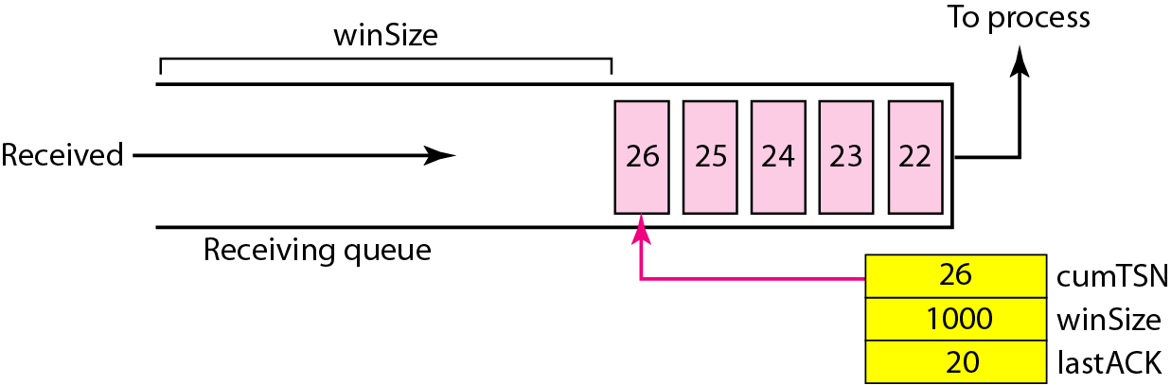
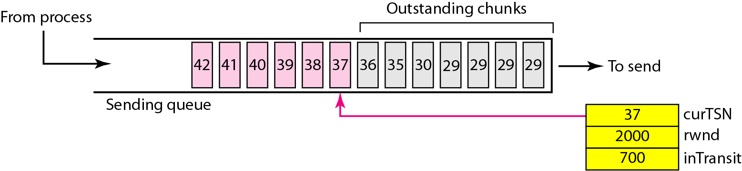
SCTP Flow Control
Flow control in SCTP is similar to that in TCP. But, SCTP use two units of data, the byte and the chunk. The value of rwnd and cwnd are expressed in byte; the value of TSN and acknowledgment are in chunks

Slide 46
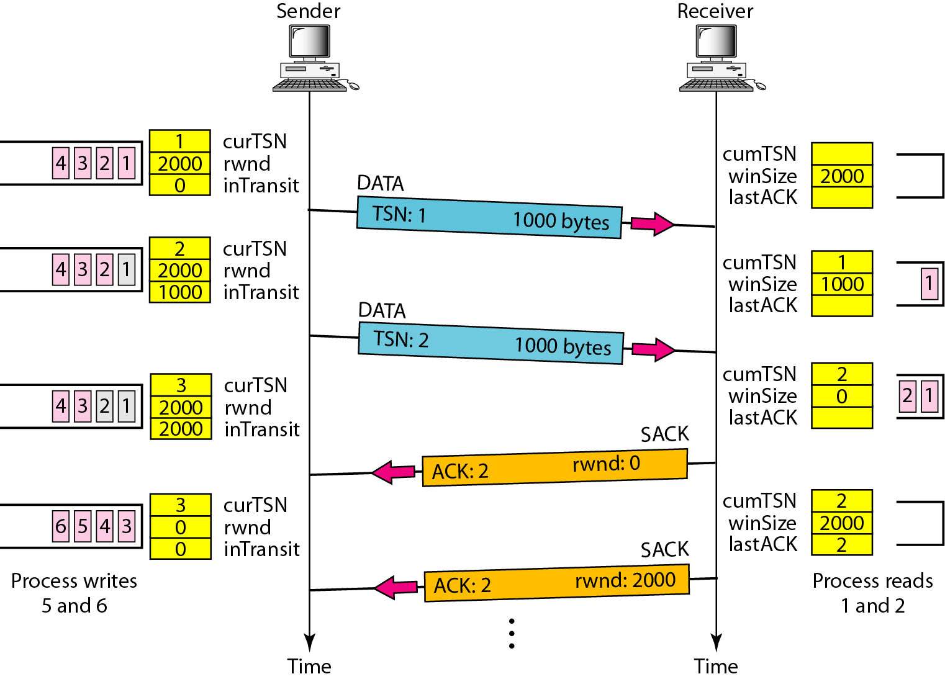
Flow Control Scenario

Slide 47
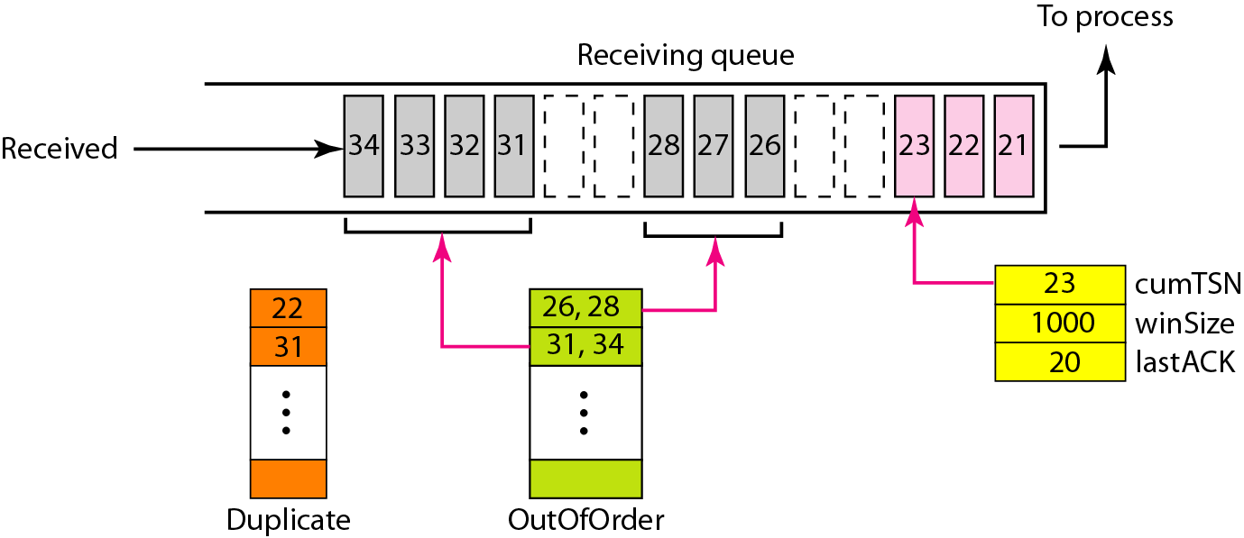
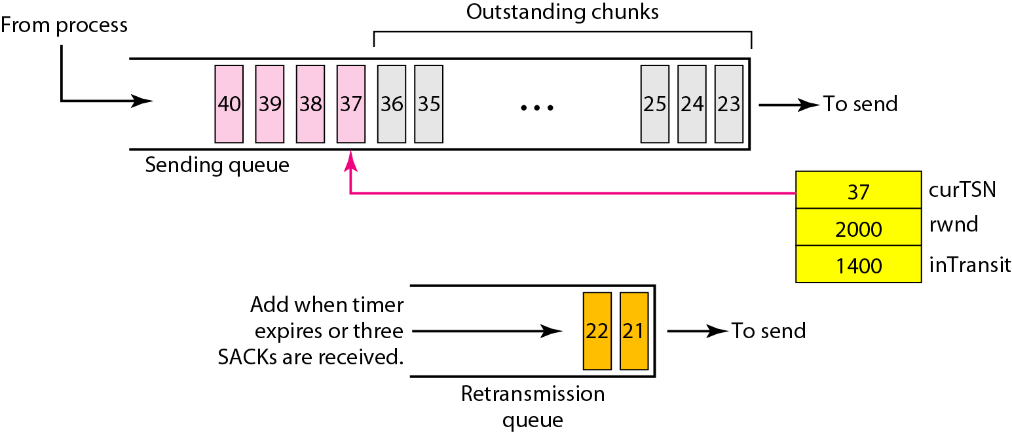
SCTP Error Control
SCTP, like TCP, is a reliable transport layer. It uses a SACK chunk to report the state of the receiver buffer to the sender

Slide 48
Error Control
Sending Data Chunks: Whenever there are data chunks in the sending queue with a TSN greater than or equal curTSN or if there are data chunks in the retransmission queue
(the total size of the data chunks included in the packet must not exceed rwnd - inTransit
Retransmission: Using retransmission timers and receiving four SACKs with the same missing chunks
Generating SACK Chunks: Similar rule used for ACK with the TCP ACK flag
Congestion Control : The same strategies in TCP (Chapter 24). SCTP has slow start (exponential increase), congestion avoidance (additive increase), and congestion detection (multiplicative decrease). SCTP also use fast retransmission and fast recovery

